Slide 1
RA Warning & Prediction Summary
Jethro WANG, CPIM

Slide 2
Agenda
System Structure – RA Warning
System Structure – RA Prediction
Method Introduction:
Machine Learning – DBSCAN
SCE & Stat Model

Slide 3
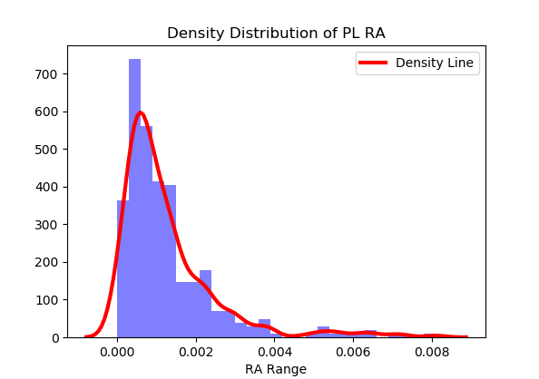
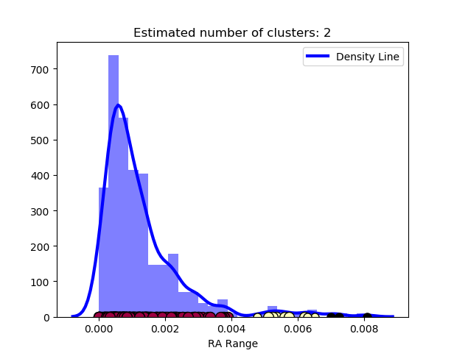
System Structure – RA Warning
RA Warning System
Qlik
IB, Usage Input
Algorithms
Biz Insights
Machine Learning
SCERA
Statistical Test
Warning Result
Coverage Install Base (IB) > 10000 Current(IB) / Max(IB) > 0.25
Alert Scenario
High RA
Abnormal Increasing
Algorithms
SCERA + Statistical Model
Machine Learning – DBSCAN**
System Implementation
Python + SQL
Tableau
Qlik
DBSCAN
Clustering
Normal Part
Risky Part

Slide 4
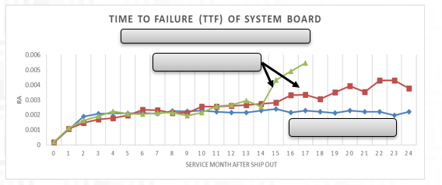
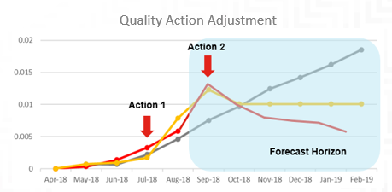
System Structure – RA Prediction
Status: Work in Progress
RA Prediction System View
Hybrid Model
Scope
WW future RA 6 months (26wks)
Product + CC & Topmost Level
Quality Action Description & Timeline
Quality Action
Usage & IB by Calendar date
Numerical Prediction
Master Data & Part Generations
Hybrid & Interpretable RA Prediction Result
Key Scenarios:
Top RA Prediction
NPI RA Prediction
Lag issue in RA calculations
Ship out quantity & ship out date
Time to Failure
Usage data by ship out date
Inputs
Algorithms
Adjustments
Outputs
Time to Failure Demo
Quality Action Adjustment Demo
Real RA
Forecast without Adjustment
Forecast with Adjustment
A base prediction for all selected scope
Strong correlation between generations in early stage
A prediction adjustment only apply to parts with quality action
Proactively adjust trend

Slide 5
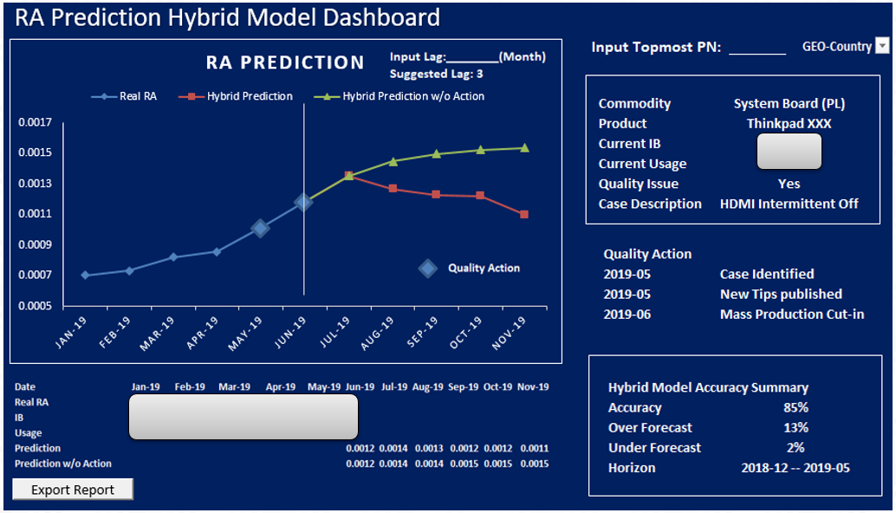
System Structure – RA Prediction (Cont.)

Slide 6
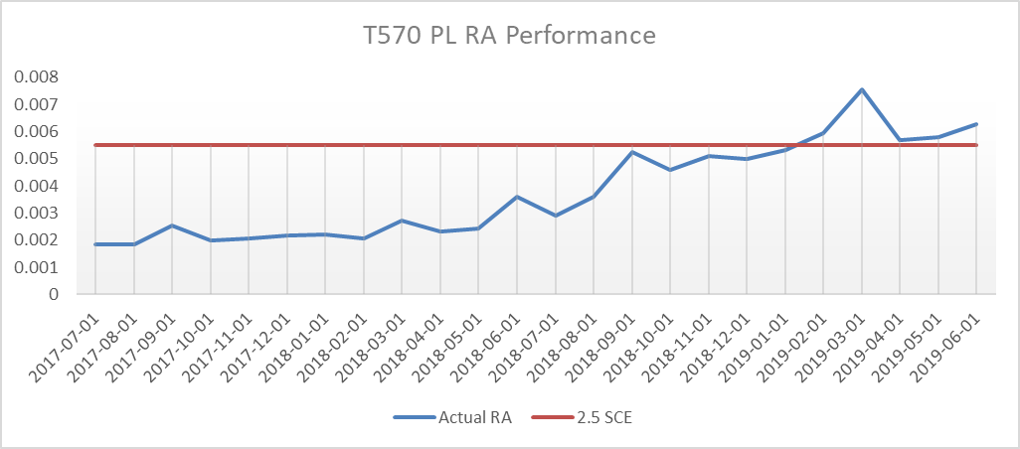
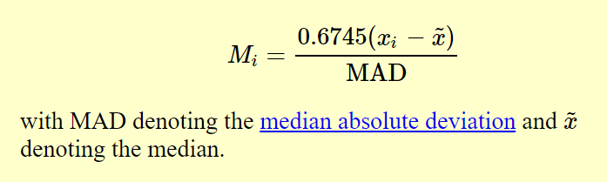
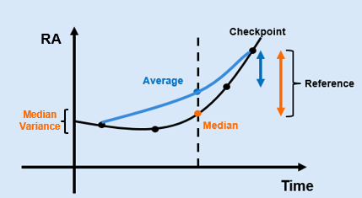

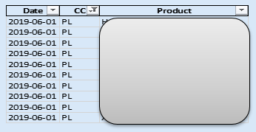
SCE & Stat Model
SCERA for high RA alert
Criteria: 2.5*SCERA
Statistics for abnormal increasing
Median Z-Test
Usage
Checkpoint
Average
Reference
RA
Median
Time
Median test is more consistent as values are ranked

Slide 7
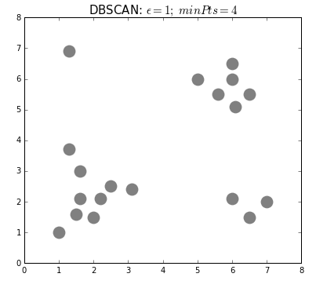
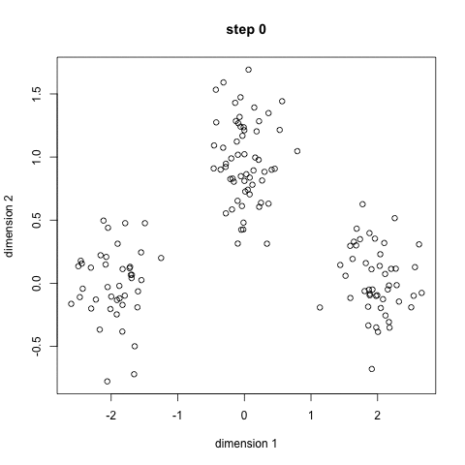
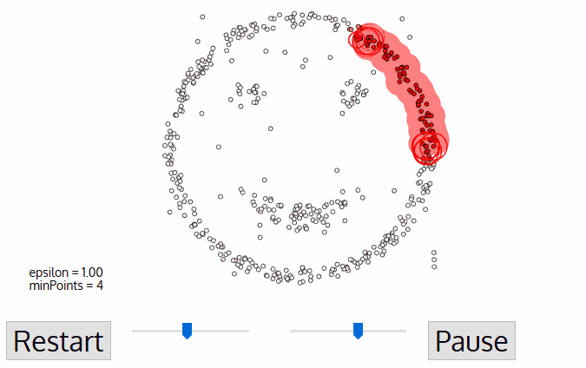
DBSCAN – Introduction
Density-Based Spatial Clustering of Applications with Noise
(DBSCAN)
A step by step introduction (in gif)
Benefits:
Dynamic criteria dealing with tricky scenarios
All good
Impact during holiday season
Quick set up and easy maintenance
Save 50% processing time
K-Means vs. DBSCAN
https://en.wikipedia.org/wiki/DBSCAN

